Slide 1
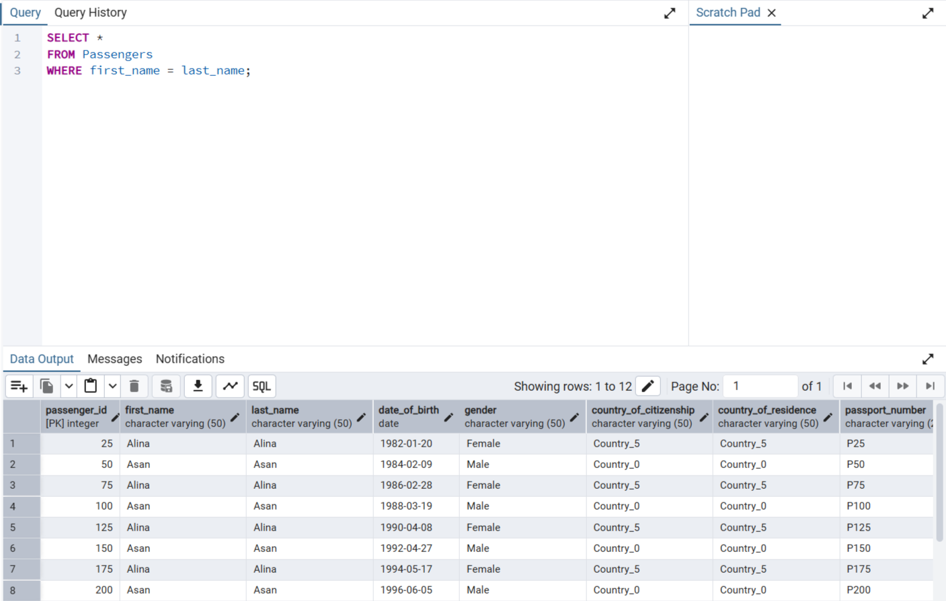
TASK #1

Slide 2
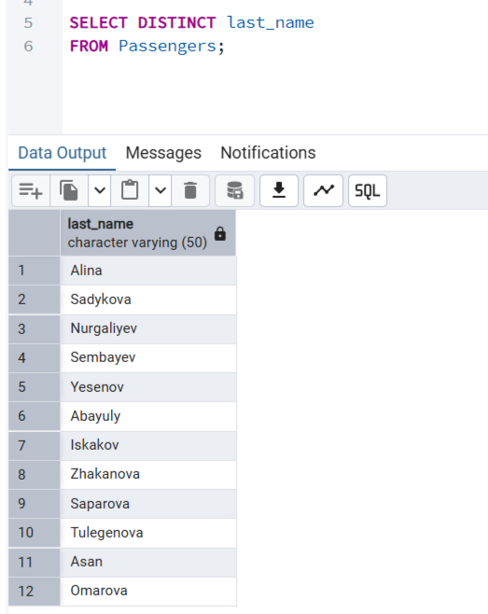
TASK # 2

Slide 3
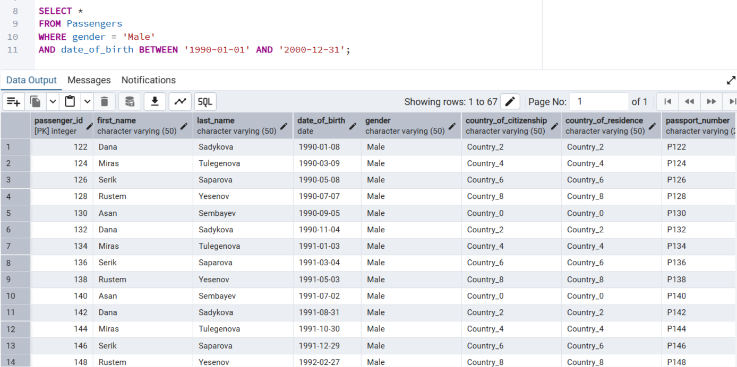
TASK # 3

Slide 4
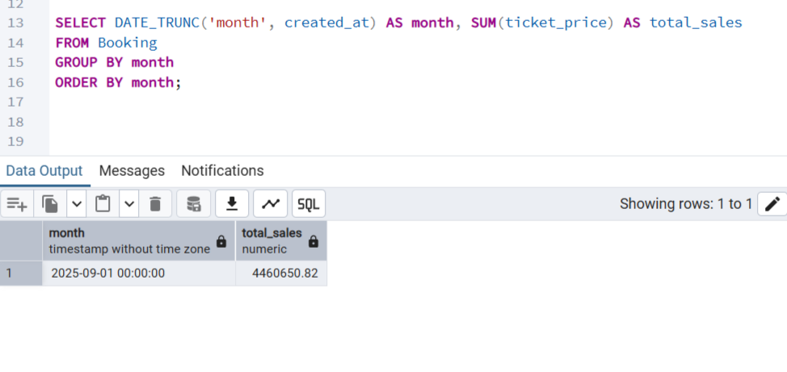
TASK # 4

Slide 5

TASK #5

Slide 6

TASK #6

Slide 7
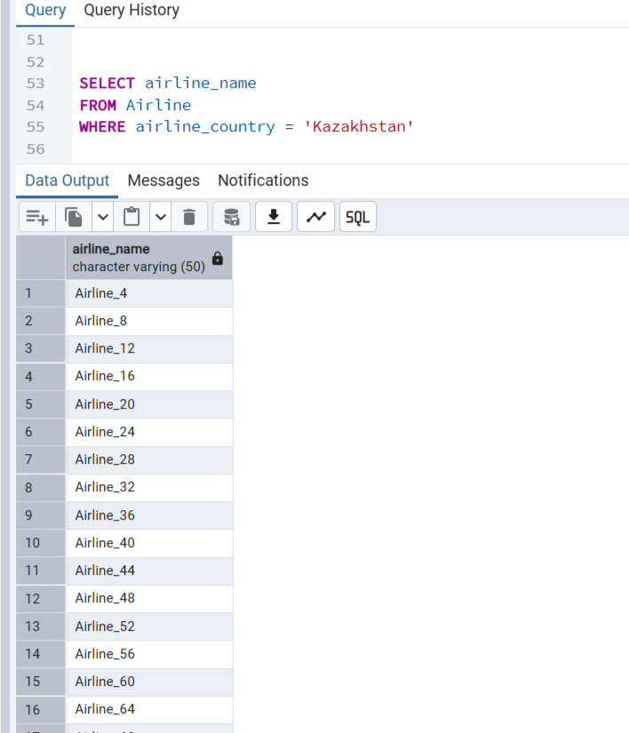
TASK #7

Slide 8
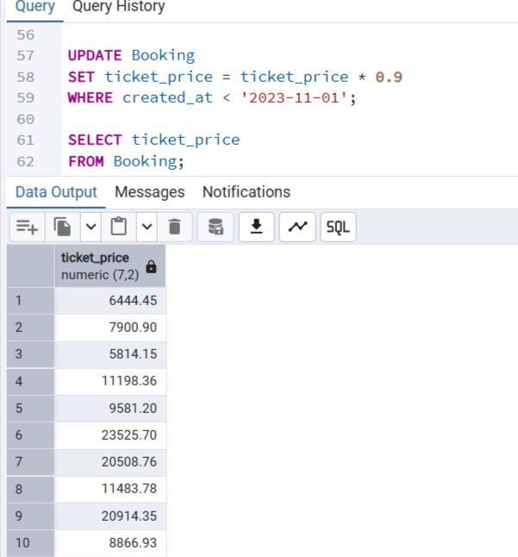
TASK #8

Slide 9
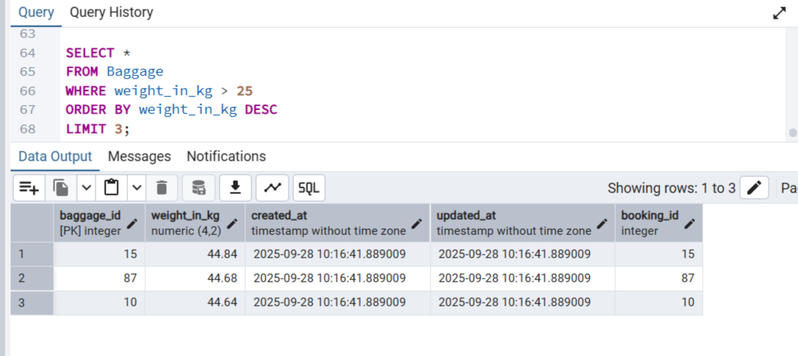
TASK #9

Slide 10
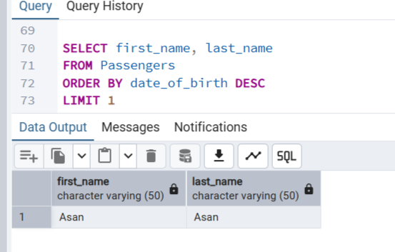
TASK #10

Slide 11
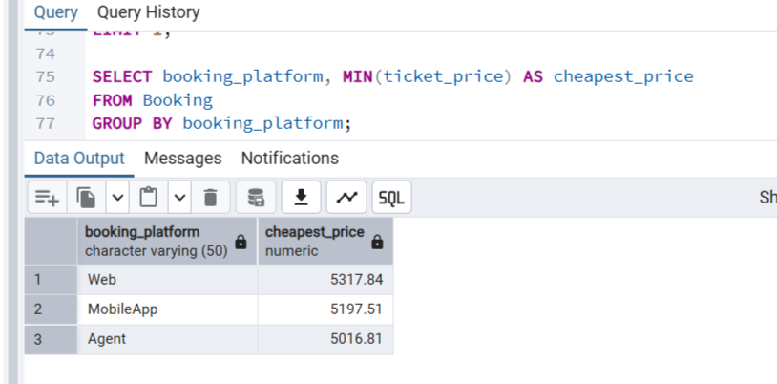
TASK #11

Slide 12
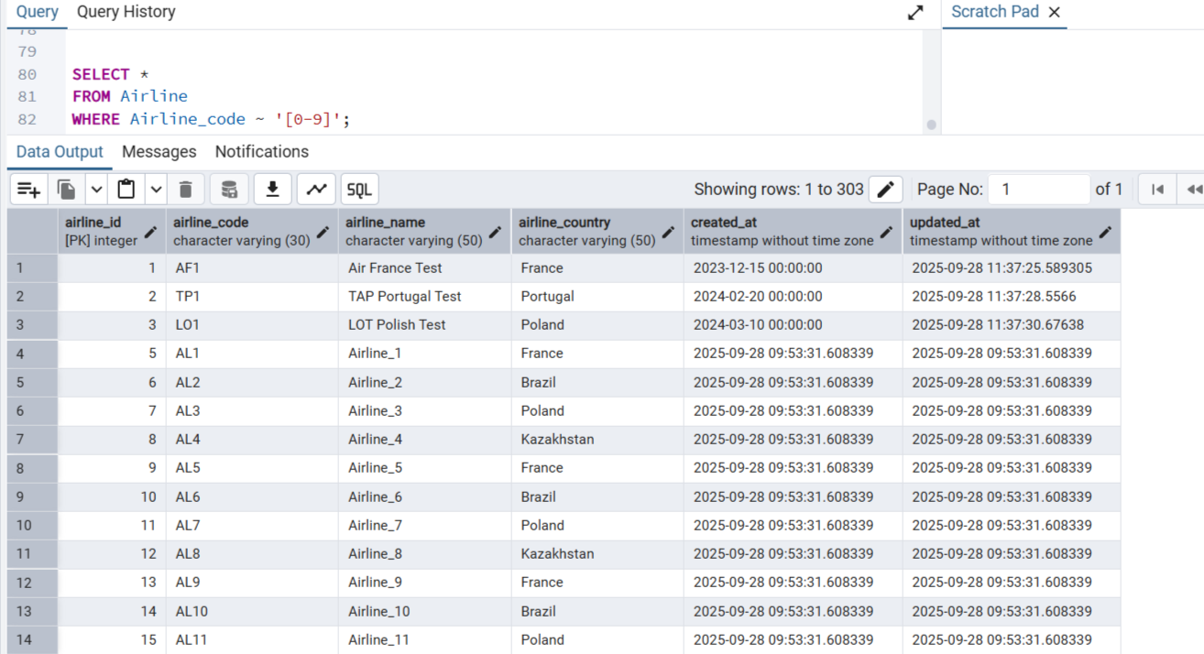
TASK #12

Slide 13

TASK #13

Slide 14
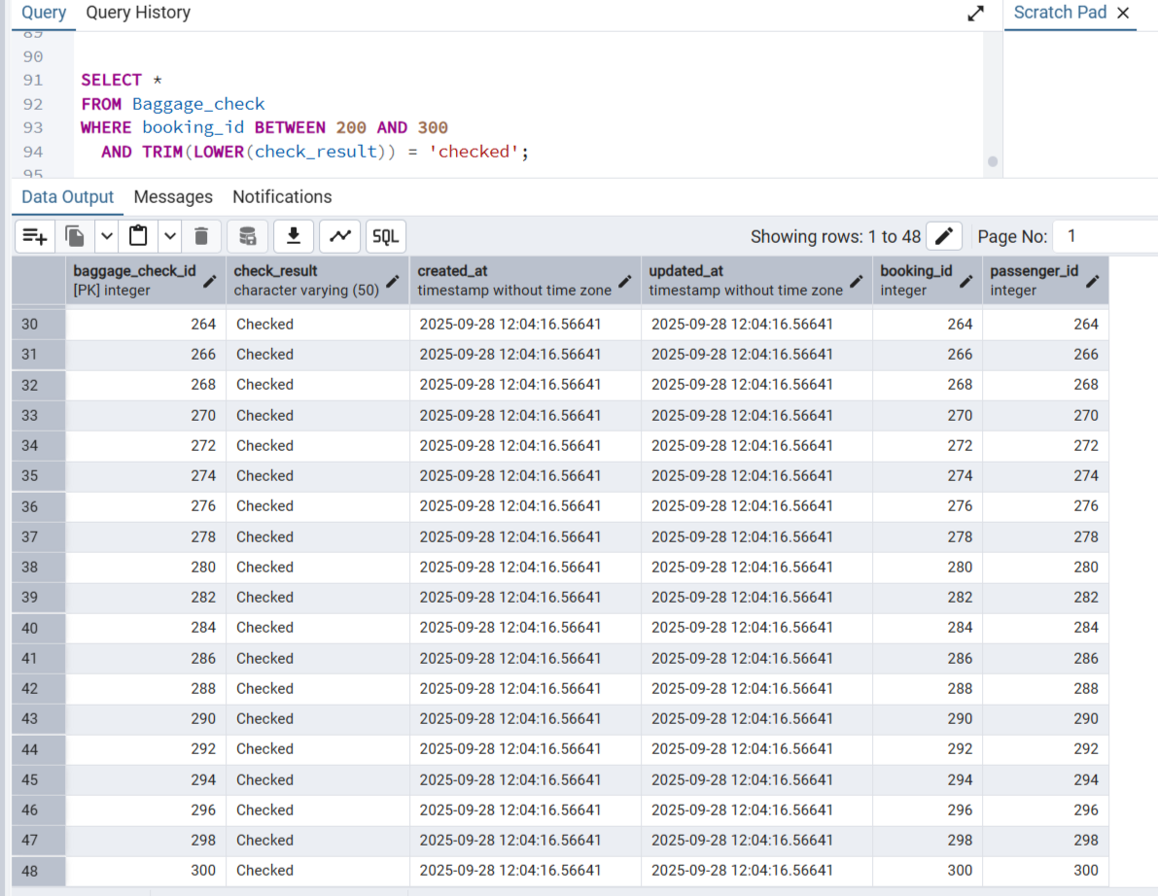
TASK #14

Slide 15

TASK #15

